Slide 1
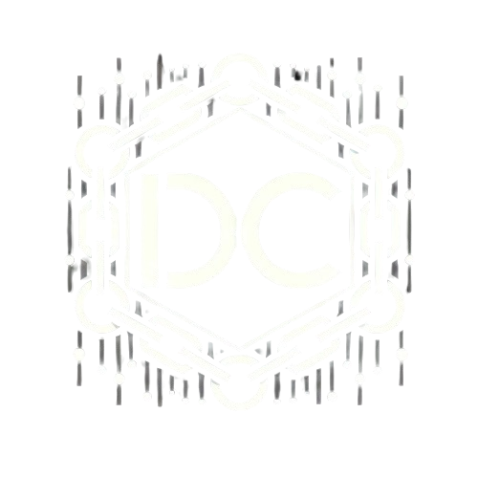
Democracy chain

Slide 2
Our team
Rahil Saini
Hardik Pradhan
Shashank Jangid
Tanish Sunita Pareek

Slide 3
PROBLEM STATEMENT
The integrity and accessibility of electoral processes are crucial for democracy, yet traditional voting methods face issues like fraud, lack of transparency, and participation barriers. There is a need for a secure and transparent digital voting system that utilizes blockchain technology to enhance election reliability and ensure that every vote is accurately recorded and counted. This initiative aims to create a trustworthy electoral framework that boosts public confidence in the democratic process.

Slide 4
SOLUTION
Our team has developed a blockchain-based voting system utilizing Aptos smart contracts to enhance the electoral process. This innovative solution ensures the security, transparency, and integrity of votes cast in elections. By leveraging the decentralized nature of blockchain, our system eliminates the risk of fraud and manipulation, providing a tamper-proof record of all transactions.

Slide 5
Key features of our voting system include:
Enhanced Security: Aptos smart contracts enable secure execution of voting processes, ensuring that only eligible voters can cast their votes.
Transparency: Every vote is recorded on the blockchain, allowing for real-time tracking and verification, which builds public trust in the election outcome.
Accessibility: The digital platform is designed to be user-friendly, facilitating participation from a diverse range of voters, including those with disabilities.
Auditability: The immutable nature of blockchain allows for comprehensive audits of the voting process, ensuring accountability and reliability.

Slide 6
ELEMENTS WE HAVE USED
Aptos smart contract
Well done wallet
Move programming language
Aptos blockchain

Slide 7
THANK YOU

